Slide 1
PYTHON
Manoj

Slide 2
Python is an interpreted, object-oriented, high-level programming language with dynamic semantics.
Its high-level built in data structures, combined with dynamic typing and dynamic binding, make it very attractive for Rapid Application Development, as well as for use as a scripting or glue language to connect existing components together.

Slide 3
Python is an interpreted, interactive, object-oriented programming language.
It incorporates modules, exceptions, dynamic typing, very high level dynamic data types, and classes.
Python has packages that encapsulates different categories of functionality in libraries (also called packages).

Slide 4
There are two major versions of the Python programming language: the Python 2. x series, and the newer Python 3. x series.
Python 2.7
Python 3.10
Installation in Windows using PYTHON.ORG
and download Python 3.10.7

Slide 5
Python Variable :
A Python variable is a symbolic name that is a reference or pointer to an object. Once an object is assigned to a variable, you can refer to the object by that name
Variable is not start with any number.
ex: 1=9
We can use (a-z) (A-Z) & (0-9) , -

Slide 6
EX:
X=4
Y= “MANOJ”
→ Print (x)
o/p: 4
→ Print (Y)
O/P: MANOJ

Slide 7
EX :
X=3
X=4
Here 2 times given ‘x’ values
Then
→ Print (x)
4
Here it takes the latest value

Slide 8
Data Types :
Data types are the classification or categorization of knowledge items. It represents the type useful that tells what operations are often performed on specific data.

Slide 9
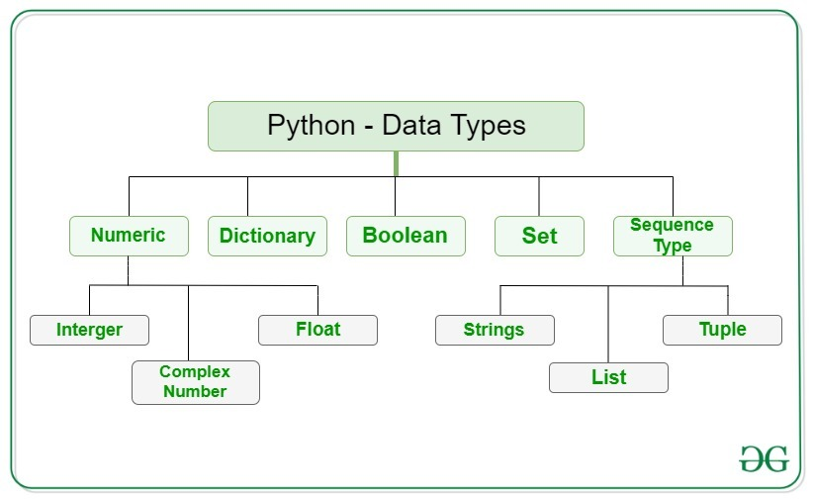

Slide 10
Types of Data types.
1.Text Type
2.Numeric Type
3.Sequence Type
4. Mapping Type
5. Set Type
6. Boolean Type
7. Binary Type
8. None Type

Slide 11
1.Text Type :
Text data type is known as Strings in Python
For example, a string might be a word, a sentence, or several sentences.
Ex : “HELLO”
“10”
2.Numeric Type :
numeric data type represent the data which has numeric value
Numeric value can be integer, floating number or complex numbers

Slide 12
Integers – This value is represented by int class. It contains positive or negative whole numbers (without fraction or decimal). In Python there is no limit to how long an integer value can be.
Ex: a = 5
print(type(a))
Output :
<class 'int'>

Slide 13
Float – This value is represented by float class. It is a real number with floating point representation. It is specified by a decimal point.
EX:
b = 5.0
print("\nType of b: ", type(b))
O/P :
<class 'float'>

Slide 14
Complex Numbers – Complex number is represented by complex class.
It is specified as (real part) + (imaginary part)j.
EX:
c = 2 + 4j
print( type(c))
OUTPUT :
<class 'complex'>

Slide 15
3.Sequence Type :
sequence is the ordered collection of similar or different data types. Sequences allows to store multiple values in an organized and efficient fashion. There are several sequence types in Python –
List
Tuple

Slide 16
List :
Lists are just like the arrays, declared in other languages which is a ordered collection of data.
It is very flexible as the items in a list do not need to be of the same type.
Lists in Python can be created by just placing the sequence inside the square brackets[].
List can Modify , Add and Delete

Slide 17
List Example:
List = [“aa”,“bb”,“cc”,“dd”,“ee”]
Print(List)
Output :
List = [“aa”,“bb”,“cc”,“dd”,“ee”]
Print(List[2])
Output:
bb
Print (List[-1])
Output :
ee

Slide 18
Tuple :
Just like list, tuple is also an ordered collection of Python objects.
The only difference between tuple and list is that tuples are immutable i.e. tuples cannot be modified after it is created.
It is represented by tuple class.
Having one element in the parentheses is not sufficient, there must be a trailing ‘comma’ to make it a tuple.

Slide 19
Tuple Example:
Tuple = [“aa”,“bb”,“cc”,“dd”,“ee”]
Print(tuple)
Output:
“aa”,“bb”,“cc”,“dd”,“ee”

Slide 20
4. Mapping Type :
Dictionary
Dictionary in Python is an unordered collection of data values,
used to store data values like a map,
which unlike other Data Types that hold only single value as an element,
Dictionary holds key: value pair.
Key-value is provided in the dictionary to make it more optimized.
Each key-value pair in a Dictionary is separated by a colon :,
whereas each key is separated by a ‘comma’.
a Dictionary can be created by placing a sequence of elements within curly {} braces, separated by ‘comma’.

Slide 21
Dictionary Example:
Dict = {1: ‘aa', 2: ‘bb', 3: ‘cc'}
print(Dict)
Outpt:
{1: ‘aa', 2: ‘bb', 3: ‘cc'}

Slide 22
Conditions :
Python supports the usual logical conditions from mathematics:
Equals: a == b
Not Equals: a != b
Less than: a < b
Less than or equal to: a <= b
Greater than: a > b
Greater than or equal to: a >= b

Slide 23
Python Conditional statements :
If-else statement
LOOP–
While loop,
For loop
3. Function
4. Array

Slide 24
If-else statement Examples :
a = 33 b = 200 if b > a: print("b is greater than a")
Output :
b is greater than a

Slide 25
Elif :
The elif keyword is pythons way of saying "if the previous conditions were not true, then try this condition".
Example
a = 33 b = 33 if b > a: print("b is greater than a") elif a == b: print("a and b are equal")
Output: a and b are equal

Slide 26
Else
The else keyword catches anything which isn't caught by the preceding conditions.
Example
a = 200 b = 33 if b > a: print("b is greater than a") elif a == b: print("a and b are equal") else: print("a is greater than b")
Output :
a is greater than b

Slide 27
While Loop :
The while loop we can execute a set of statements as long as a condition is true.
Example
Print i as long as i is less than 6:
i = 1 while i < 6: print(i) i += 1
OUTPUT :
1 2 3 4 5

Slide 28
The break Statement
With the break statement we can stop the loop even if the while condition is true:
Example
Exit the loop when i is 3:
i = 1 while i < 6: print(i) if i == 3: break i += 1
OUTPUT :
1 2 3

Slide 29
The continue Statement
With the continue statement we can stop the current iteration, and continue with the next:
Example
Continue to the next iteration if i is 3:
i = 0 while i < 6: i += 1 if i == 3: continue print(i)
OUTPUT:
1 2 4 5 6

Slide 30
For Loop :
for loop is used for iterating over a sequence (that is either a list, a tuple, a dictionary, a set, or a string).
This is less like the for keyword in other programming languages, and works more like an iterator method as found in other object-orientated programming languages.
With the for loop we can execute a set of statements, once for each item in a list, tuple, set etc.

Slide 31
For Loop EX :
Example
Print each fruit in a fruit list:
fruits = ["apple", "banana", "cherry"] for x in fruits: print(x)
OUTPUT:
apple banana cherry

Slide 32
3. Functions :
A function is a block of code which only runs when it is called.
You can pass data, known as parameters, into a function.
A function can return data as a result.
In Python a function is defined using the def keyword:
Ex: def my_function(): print("Hello from a function")

Slide 33
Calling a Function :
To call a function, use the function name followed by parenthesis:
Example:
def my_function(): print("Hello from a function") my_function()
OUTPUT:
Hello from a function

Slide 34
Arguments :
Information can be passed into functions as arguments.
Arguments are specified after the function name, inside the parentheses. You can add as many arguments as you want, just separate them with a comma.

Slide 35
Ex:
def my_function(fname): print(fname + " Refsnes") my_function("Emil") my_function("Tobias") my_function("Linus")
Output:
Emil Refsnes Tobias Refsnes Linus Refsnes

Slide 36
4. Array :
Arrays are used to store multiple values in one single variable
Ex: Create an array containing car names:
cars = ["Ford", "Volvo", "BMW"]
Output :
['Ford', 'Volvo', 'BMW']

Slide 37
An array is a special variable, which can hold more than one value at a time.
If you have a list of items (a list of car names, for example), storing the cars in single variables could look like this
car1 = "Ford" car2 = "Volvo" car3 = "BMW"

Slide 38
You refer to an array element by referring to the index number.
Example
Get the value of the first array item:
x = cars[0]
Output:
Ford

